Slide 1
Lecture 3: Visualizations & considerations for binarizing serological data
May 22, 2025
Seroanalytics Training Blantyre, Malawi

Slide 2
Lecture outline
Data visualization
Why binarize serological data?
Calculating seroprevalence from a cutoff
Selecting controls
Notes:
Now that we’ve completed the pre-processing step of the data, we will focus today on starting to draw inferences from our data, namely in ways to find seroprevalence.
Before that, let’s first look at our sample data.
Its important to visually inspect your data to determine if there is anything unusual before you get started applying equations

Slide 3
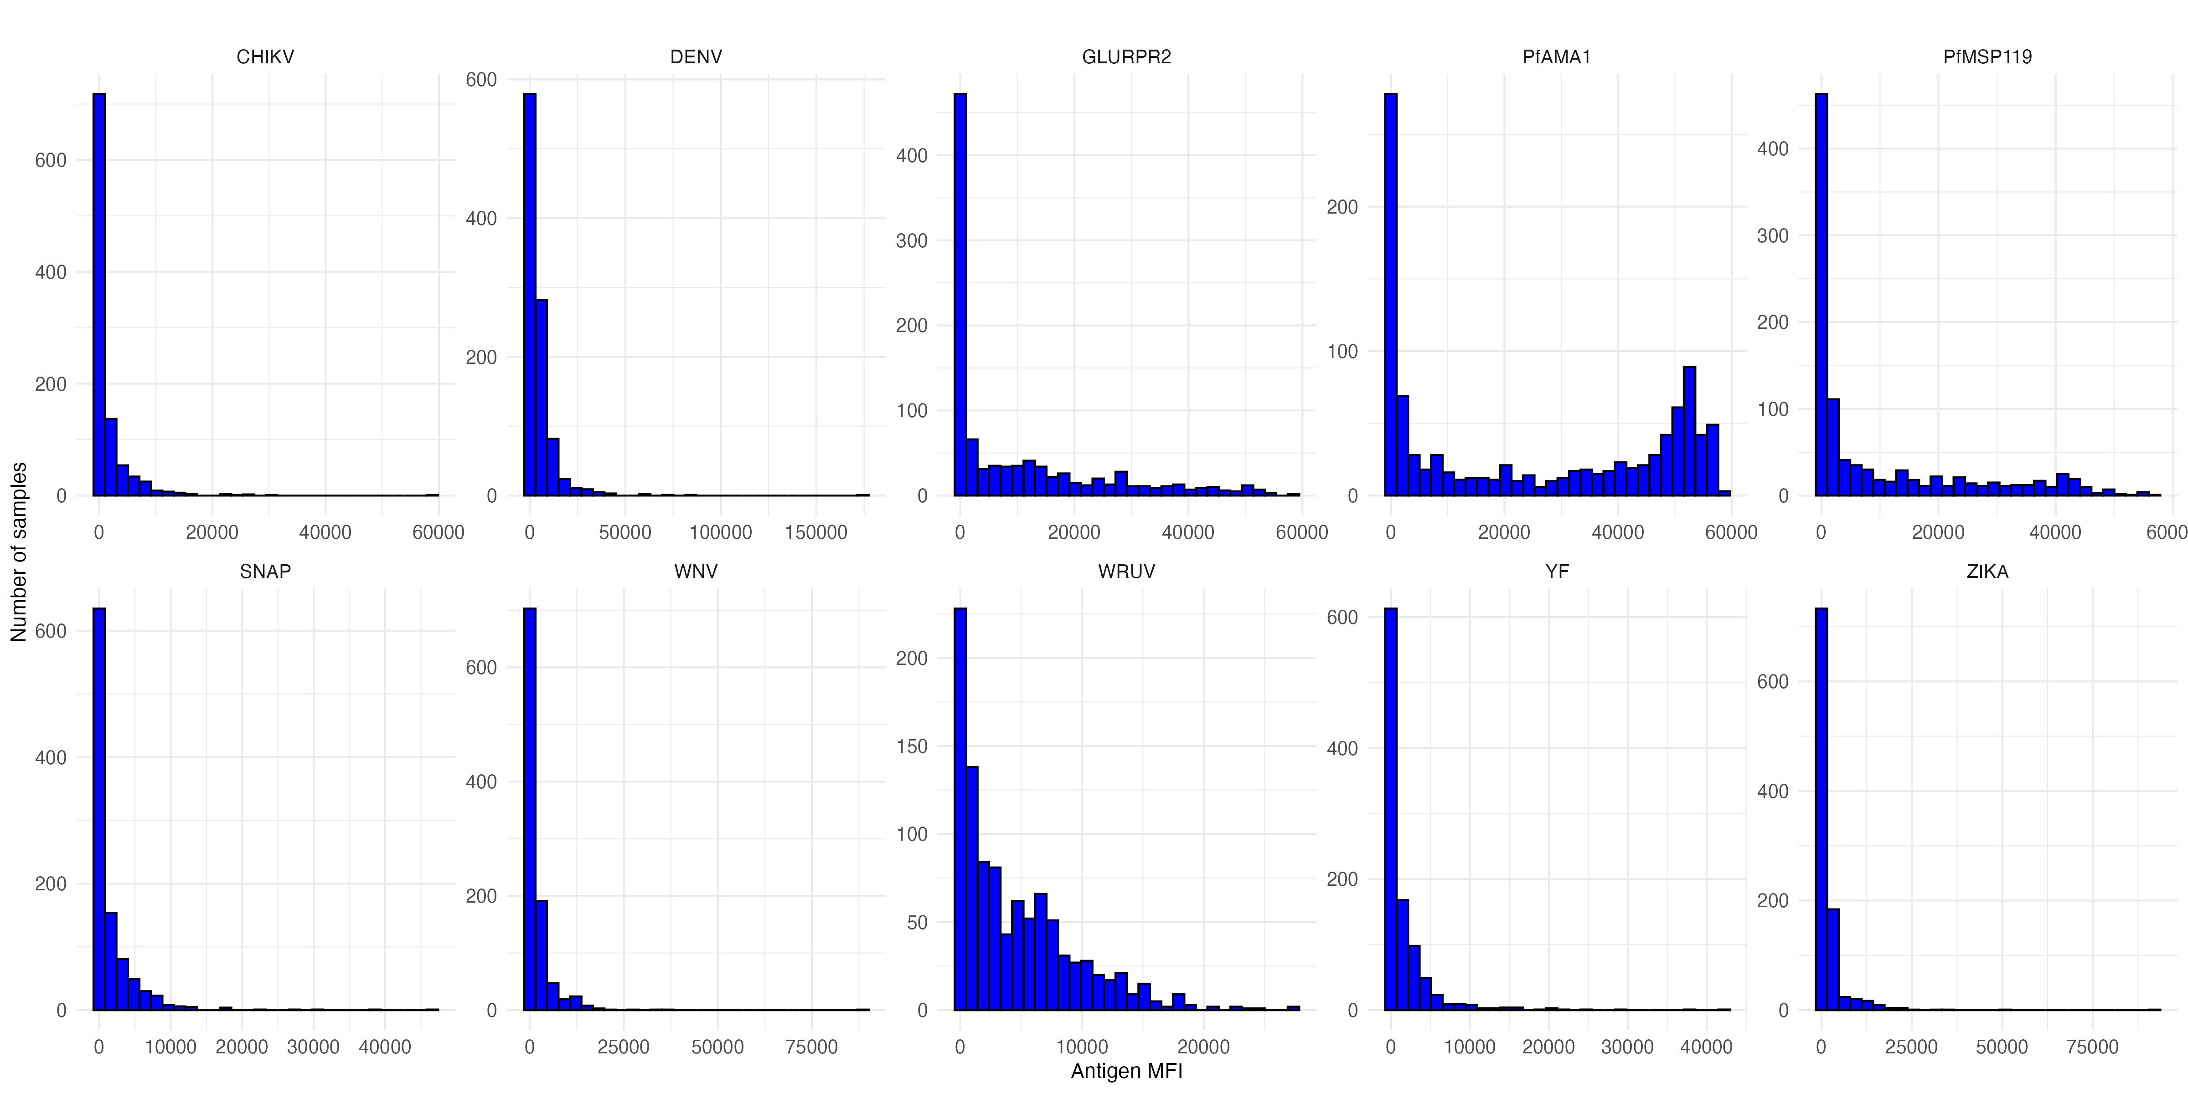
Visualizing serological data with histograms
How would you compare the different distributions of data (untransformed)?

Slide 4
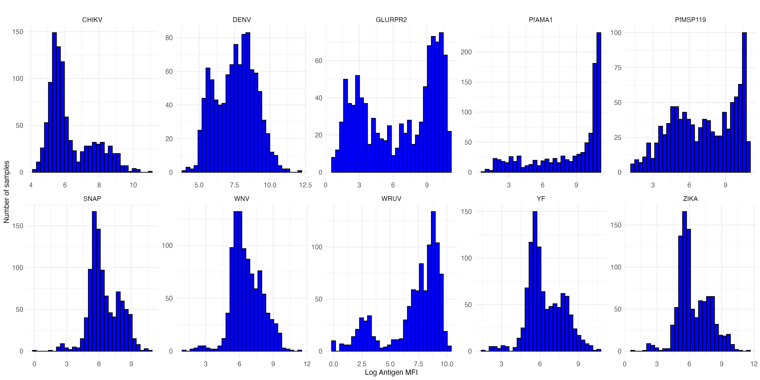
Visualizing serological data with histograms
How would you compare the different distributions of data (log transformation)?
Notes:
wruv (rubella)
Wmev = measles
Wruv – 8 pt standard curve for lecture
Wmev – 11 pt curve for lab
Neg controls for: CSP, GLURPR2, JE3, AMA1, MSP119, WNV, YF, ZIKA
Missing controls for: CHIKV, DENV
St curves but no controls for: WRUV and WMEV
Control antigen SNAP
For lecture- remove antigens from plots: WMEV, JE3, CSP
Use these in lab: WMEV, JE3, CSP

Slide 5
Visualizing serological data with histograms
How would you compare the different distributions of data?
Skewed vs. non-skewed distributions
Unimodal vs. bimodal vs. multimodal
Narrow or wide distribution
Are there outliers?
Notes:
Useful to look at overall distribution, see if there are patterns. Is there one peak or multiple peaks? Narrow or wide distribution?
Also do common sense checks – strange outliers

Slide 6
Visualizing serological data with histograms
What underlying differences might cause the different distributions of data?

Slide 7
Visualizing serological data with histograms
What underlying differences might cause the different distributions of data?
Mix of exposed and unexposed in population
Mix of vaccinated / unvaccinated
Waning antibody responses
Notes:
What exposure patterns could lead to what distributions?
Could see a bimodal distribution if there is a mix of exposed and unexposed in population
Could see unimodal distribution if most people get exposed but have waning antibodies, or if exposure without symptomatic infection could lead to smaller immune response. Does vaccine vs. natural infection elicit different responses?

Slide 8
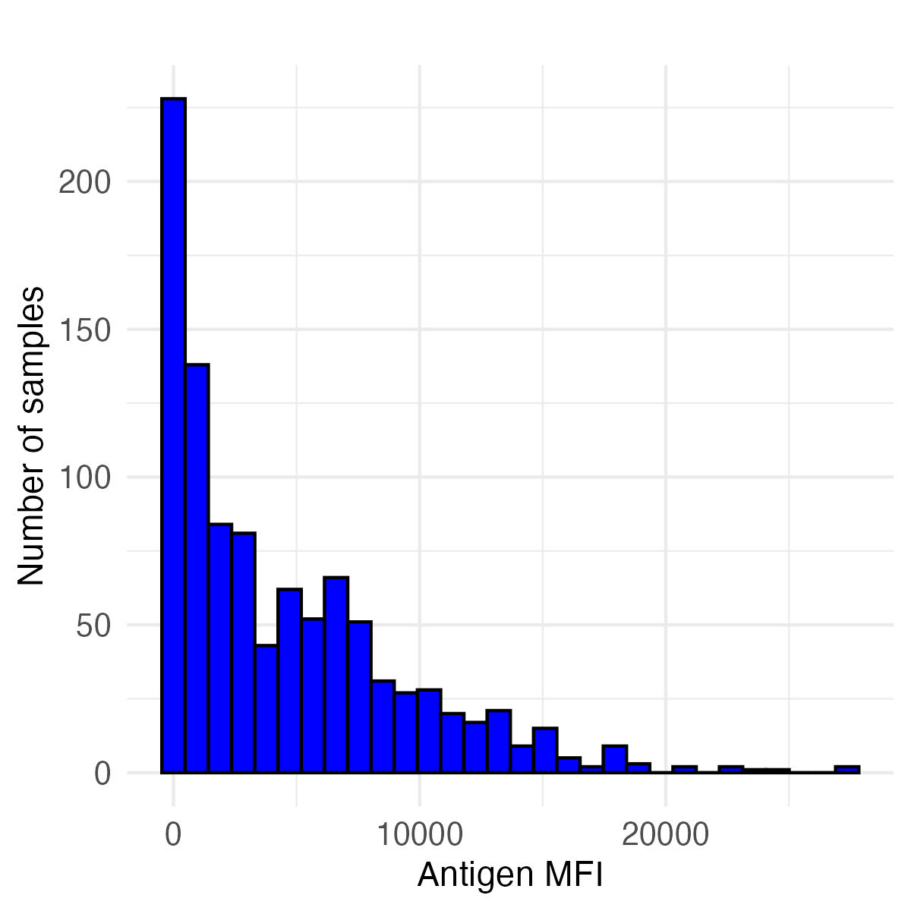
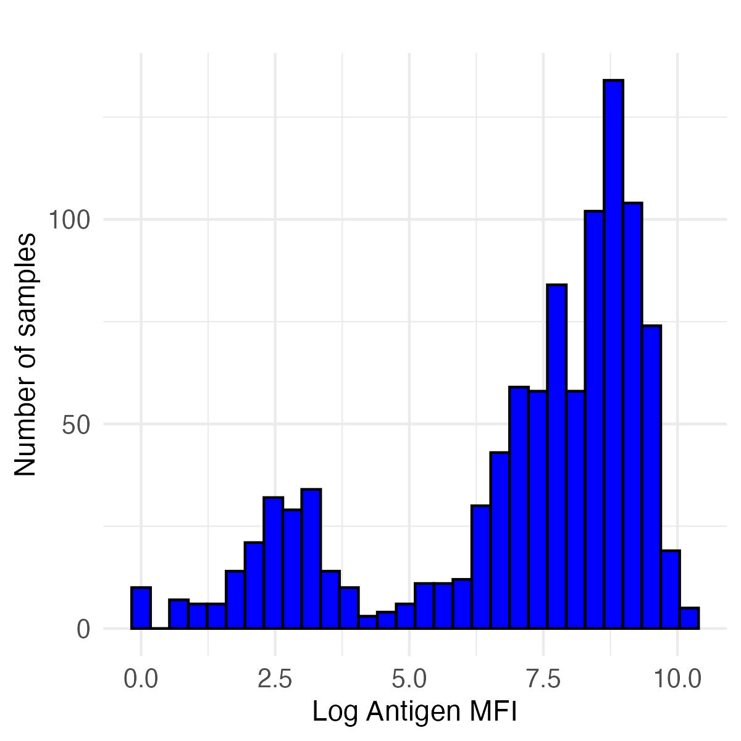
Histograms of rubella (wruv) antibody responses
Untransformed MFI Values Log transformed MFI values
How to get information from histograms like these?
How to compare the results of different histograms?
What inferences can we make about pathogen exposure based on a histogram?
A method of making inferences from distributions is binarizing data
Setting a cutoff, and everything above that cutoff is positive
Notes:
wruv (rubella)
Motivation and discuss how binarizing data can be useful to interpret a lot of information (5 min):
Example of Histogram of MFI from Measles
Show multiple histograms together. How to synthesize lots of information at once? How to compare overall histograms?
Easier to look at information if binarize it

Slide 9
Histograms of rubella (wruv) antibody responses
Untransformed MFI Values Log transformed MFI values
Rubella has a correlate of protection
Individuals with antibody responses above a certain cutoff are expected to be protected from rubella infection
By applying a cutoff equivalent to the correlate of protection, we can calculate seroprevalence (here, also equals the immune proportion)
Notes:
Seroprevalence = proportion of people protected from infection
Motivation and discuss how binarizing data can be useful to interpret a lot of information (5 min):
Example of Histogram of MFI from Measles
Show multiple histograms together. How to synthesize lots of information at once? How to compare overall histograms?
Easier to look at information if binarize it

Slide 10
Histograms of rubella (wruv) antibody responses
Untransformed MFI Values Log transformed MFI values
Rubella correlate of protection is 9.36 IU/ml (International Units per milliliter)
However, the Luminex assay gives us antibody units in MFI (median fluorescence intensity)
We can convert between MFI and IU/ml using a standard curve: we convert all MFI values to IU/ml, and apply the 9.36 IU/ml cutoff
Notes:
Motivation and discuss how binarizing data can be useful to interpret a lot of information (5 min):
Example of Histogram of MFI from Measles
Show multiple histograms together. How to synthesize lots of information at once? How to compare overall histograms?
Easier to look at information if binarize it

Slide 11

Getting MFI values from standard curves
The standard curve is created using known concentrations of antibody standards (e.g., the WHO International Standard for rubella, below), ideally measured on the same plate(s) as the unknown samples.
https://nibsc.org/documents/ifu/RUBI-1-94.pdf
Notes:
Example with measles- well-defined correlate of protection (15 min, with students putting in code as well)
Easy to justify using cutoff when there is a correlate of protection
To get MFI, we must use standard curve to convert international units to MFI.
To convert this, we need to use standards from controls samples that were tested at different known concentrations that will have different UIs. From this, we can convert the standardized UI to an MFI value that we can compare to our data.
The standard curve is created using known concentrations of antibody standards, measured on the same plate as the unknown samples.
First we fit a model to our data to establish the relationship between MFI values and known IU/mL concentrations.
Chatgpt prompt: in the same style as you did previously, write a section describing how to use the results of a standard curve. Standard curve is on a plate with results as MFI values from a multiplex bead assay. I want to use results from a standard curve to then convert international units to mfi to determine the cutoffs in a serological surveillance study.

Slide 12
Converting MFI values to standardized units (IU/ml) from standard curves
(Recall we used standard curves to estimate relative antibody units.)
First, we fit a model to our standard curve data to establish the relationship between MFI values and known IU/mL concentrations.
Then, we can use this model to convert MFI values for the samples of interest to IU/ml.
Lastly, we apply the 9.36 IU/ml correlate of protection cutoff to the samples of interest to determine a binary serostatus for each sample.
Notes:
Example with measles- well-defined correlate of protection (15 min, with students putting in code as well)
Easy to justify using cutoff when there is a correlate of protection
To get MFI, we must use standard curve to convert international units to MFI.
To convert this, we need to use standards from controls samples that were tested at different known concentrations that will have different UIs. From this, we can convert the standardized UI to an MFI value that we can compare to our data.
The standard curve is created using known concentrations of antibody standards, measured on the same plate as the unknown samples.
First we fit a model to our data to establish the relationship between MFI values and known IU/mL concentrations.
Chatgpt prompt: in the same style as you did previously, write a section describing how to use the results of a standard curve. Standard curve is on a plate with results as MFI values from a multiplex bead assay. I want to use results from a standard curve to then convert international units to mfi to determine the cutoffs in a serological surveillance study.

Slide 13
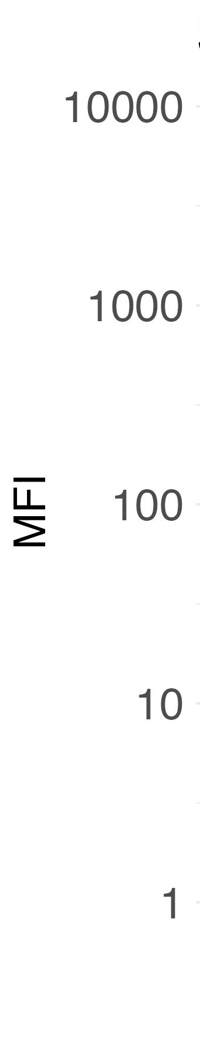
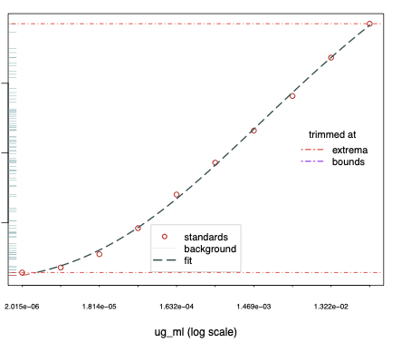
Converting MFI values to standardized units (IU/ml) from standard curves
For rubella (WRUV), we can apply the cutoff (based on correlate of protection) of 9.36 IU/ml to determine individual serostatus
cutoff (9.36 IU/mL)
observed sample data
1 10 100
WRUV concentration (IU/mL)
Notes:
Example with measles- well-defined correlate of protection (15 min, with students putting in code as well)
Easy to justify using cutoff when there is a correlate of protection
To get MFI, we must use standard curve to convert international units to MFI.
To convert this, we need to use standards from controls samples that were tested at different known concentrations that will have different UIs. From this, we can convert the standardized UI to an MFI value that we can compare to our data.
The standard curve is created using known concentrations of antibody standards, measured on the same plate as the unknown samples.
First we fit a model to our data to establish the relationship between MFI values and known IU/mL concentrations.
Chatgpt prompt: in the same style as you did previously, write a section describing how to use the results of a standard curve. Standard curve is on a plate with results as MFI values from a multiplex bead assay. I want to use results from a standard curve to then convert international units to mfi to determine the cutoffs in a serological surveillance study.

Slide 14
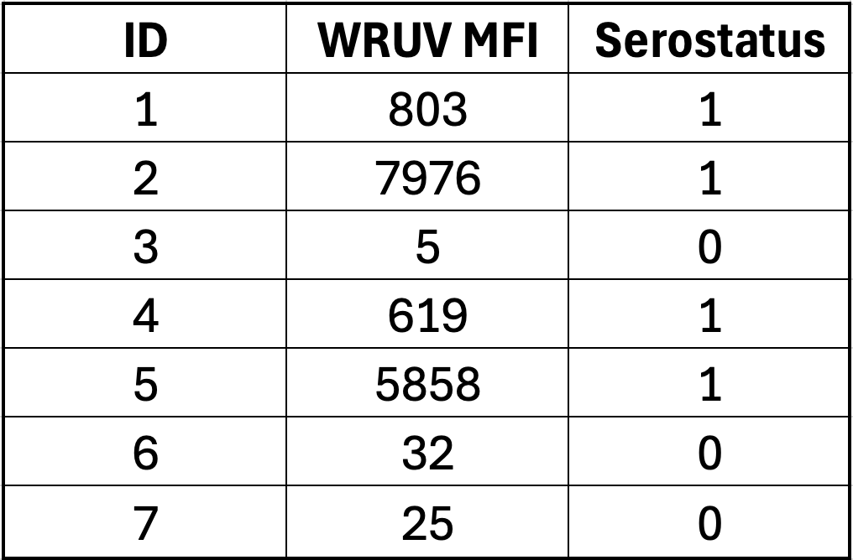
Determining serostatus from a cutoff
For each sample in the dataset, we identify each as seropositive (1) or seronegative (0)

Slide 15
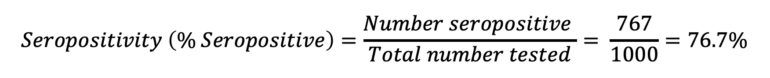
Calculating seropositivity or seroprevalence
For WRUV with a cutoff of 9.36 IU/ml, we have:
767 seropositive samples
233 seronegative samples
$$Seropositivity \left(\% Seropositive\right)=\frac{Number seropositive }{Total number tested}= \frac{767}{1000}=76.7\%$$

Slide 16
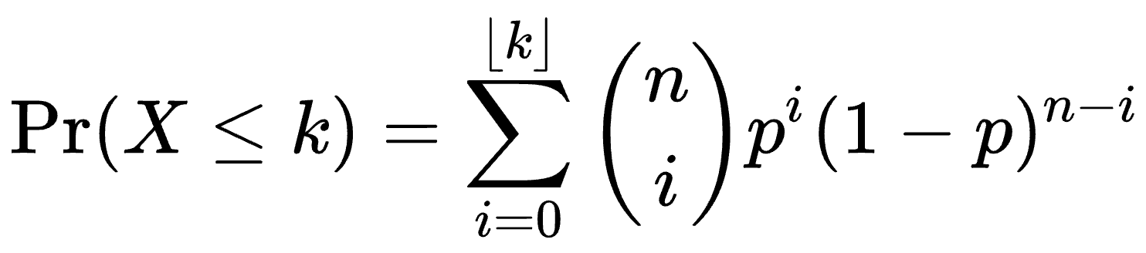
Calculating seropositivity – confidence intervals
Estimating uncertainty is important for capturing true population seroprevalence; it typically accounts for variance around a mean estimate.
Estimating a 95% confidence interval means that in 95 out of 100 calculations of seroprevalence from the same source population using 1000 individuals, the range will include the true population-level seroprevalence.
This method uses a binomial distribution and accounts for the number of people sampled – luckily, we can use R to easily compute it:
With 767 positive individuals and 1000 individuals total, the 95% CI is: 74.0% - 79.3%.

Slide 17
Calculating seropositivity – confidence intervals
With 767 positives and 1000 total samples:
Seroprevalence = 76.7% (95% CI: 74.0%, 79.3%)

Slide 18
Question: How do we interpret seroprevalence?
Interpretation strongly depends on how seroprevalence is determined, including controls used and selected cutoff.
For the seroprevalence of rubella (WRUV):
Percentage of people who have been exposed to vaccine or natural infection.
If we know there’s no/little vaccination, we may assume seroprevalence is due to natural infection, or vice versa.
Since cutoff is a correlate as protection, seroprevalence could also indicate which individuals are susceptible to future infection, and whether there could be outbreaks in a region.
Notes:
Interpretation of these numbers: ask participants what they think (5-10 min with discussion)
Percentage of people who have been exposed to vaccine or natural infection
How might interpretation change based on what we know about measles spread in region and spread of vaccination (eg, if there’s no/little vaccination in area, we could interpret seroprevalence as indication of spread of disease, and if there’s little evidence of disease in area, this is more indication of vaccination
Cutoff is correlate as protection, so could also show which individuals are susceptible to future infection, and whether there could be outbreaks in region

Slide 19
Question: How do we interpret seroprevalence?
How would we interpret seroprevalence if there is NOT a correlate of protection?
Notes:
Interpretation of these numbers: ask participants what they think (5-10 min with discussion)
Percentage of people who have been exposed to vaccine or natural infection
How might interpretation change based on what we know about measles spread in region and spread of vaccination (eg, if there’s no/little vaccination in area, we could interpret seroprevalence as indication of spread of disease, and if there’s little evidence of disease in area, this is more indication of vaccination
Cutoff is correlate as protection, so could also show which individuals are susceptible to future infection, and whether there could be outbreaks in region

Slide 20
Question: How do we interpret seroprevalence?
How would we interpret seroprevalence if there is NOT a correlate of protection?
For antigens in general, seroprevalence could indicate:
Population ever exposed to pathogen or vaccine
Population with recent infection
Population with symptomatic infection
Cross-reactive antibody responses

Slide 21
Controls
If we don’t have a correlate of protection, we can use control samples to determine cutoffs for seropositivity.
Ideally, we could have positive and negative controls.
Often, we only have negative controls, and sometimes we don’t have positive or negative controls.
The controls we use to establish cutoffs can affect our interpretation of seroprevalence.
Notes:
Controls necessary for many cutoff methods (15 min)
For most diseases, we don’t have a correlate of protection
Seropositivity using different cutoffs may have different interpretations. Consider how to interpret seropositivity for the cutoff methods you apply.

Slide 22
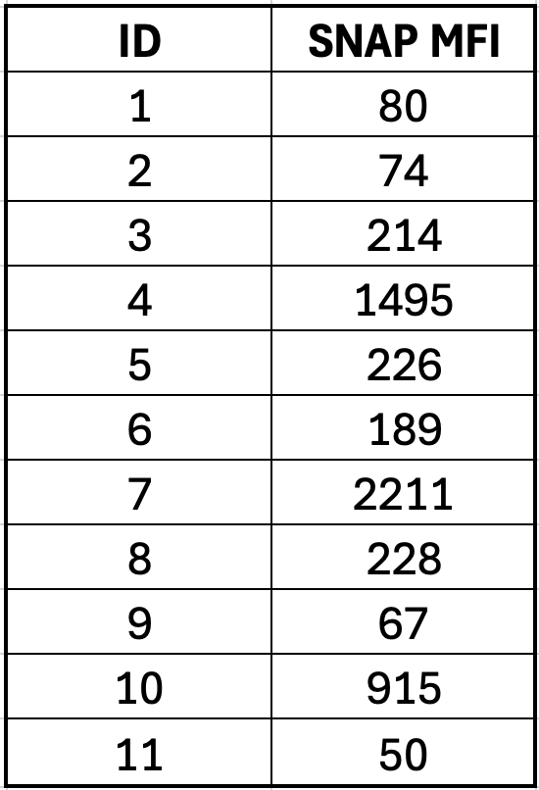
Non-target antigen controls
We also have controls with non-target antigens (SNAP in our dataset, other common ones are GST and Vero cell).
These controls can ensure that the plate ran correctly, whether values are similar between plates, and high values can indicate non-specific binding.
The non-target antigen values should ideally not differ between samples with high and low antigen values.

Slide 23
Positive controls
Often, positive controls are based on antibody responses from people who have symptomatic disease.
How might positive controls differ from positives in samples?

Slide 24
Positive controls
Often, positive controls are based on antibody responses from people who have symptomatic disease.
How might positive controls differ from positives in samples?
Vaccination vs. natural infection
Intensity of infection – severe, symptomatic, asymptomatic – (controls may be more likely to have clinical or severe infection)
Timing since infection (controls likely were taken from acute infection phase)

Slide 25
Negative controls
What populations might be best to get negative controls from?

Slide 26
Negative controls
What populations might be best to get negative controls from?
Non-endemic area (likely to be adults)
Very young presumed unexposed (likely to be from target population)

Slide 27
Negative controls
What populations might be best to get negative controls from?
Non-endemic area (likely to be adults)
Very young presumed unexposed (likely to be from target population)
Why would you choose to get - or not get - controls from each of these populations?

Slide 28
Negative controls
What populations might be best to get negative controls from?
Non-endemic area (likely to be adults)
Very young presumed unexposed (likely to be from target population)
Why would you choose to get - or not get - controls from each of these populations?
Controls from non-endemic area may differ from target population in many ways (geographic, socioeconomic, disease history)
Very young immune systems vs. adult immune systems
Notes:
Ask trainees: What populations might be best to get negative controls from?
Non-endemic area (likely to be adults)
Very young presumed unexposed (likely to be from target population)
Discusses pros/cons of each of these. Idea that controls should be most similar to counterfactual exposed population that is otherwise exactly the same
In practice, you may not have ideal controls and will make do with what you have

Slide 29
Controls
You may not have ideal controls.
You should understand the assumptions/biases of your controls!

Slide 30
Conclusions
You should visualize your data before conducting analysis.
It can be useful to classify samples as seropositive and seronegative, and to calculate seropositivity.
It’s important to understand the controls you use, and how these will affect your inference.

